Slide 1
Building Graphical Applications with PowerShell 2.0
James Tyler

Slide 2

Overview
Introduction
PowerShell Pro Tools
PoshGUI.com
Overview of WinForm Controls
Build a User Add App
Converting PowerShell to .exe

Slide 3


About Me
Director of Technology Niles Community Schools & River Valley School District Author of PowerShell for Systems Engineers 100K+ Views on YouTube @PowerShellEngineer President of Watervliet Baseball/Softball Rec Council

Slide 4
About Me
Presenter at MAEDS 2022
PowerShell GUIs
PowerShell Storage Automation with AWS, Azure & GCP
Brief Presenter at MAEDS 2019
Chris Thomas/Eric Krebill PowerShell Session

Slide 5
SoapBox Time…
Don’t fall victim to imposter syndrome!
I’m going to put on my Chris Thomas hat…
Everyone has something valuable to share
Present next year!

Slide 6
PowerShell Resources
PowerShell Podcast https://www.youtube.com/playlist?list=PL1mL90yFExsjUS8DRkzfLUcHds7vlxqgM
New York PowerShell Meetup https://www.meetup.com/NycPowershellMeetup/
Steve Lee, Principal Software Engineering Manager of PowerShell https://twitter.com/steve_msft
Jeff Hicks Newsletter - “Behind the Pipeline” https://jeffhicks.substack.com/

Slide 7
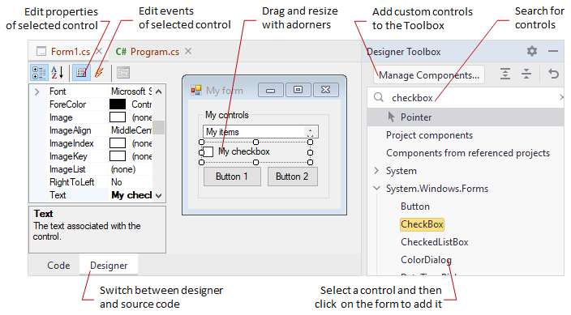
Why use graphical apps?
Make repeated tasks easier
Make repeated tasks faster
Make repeated tasks more accurate
Make tools portable for frontline technical staff

Slide 8


Slide 9
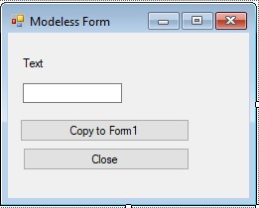
What are Windows Forms?
Windows Forms is a UI framework for building Windows desktop apps. It provides one of the most productive ways to create desktop apps based on the visual designer provided in Visual Studio. Functionality such as drag-and-drop placement of visual controls makes it easy to build desktop apps.

Slide 10
Simplicity in Design
Simplicity in Coding
Why Windows Forms?

Slide 11
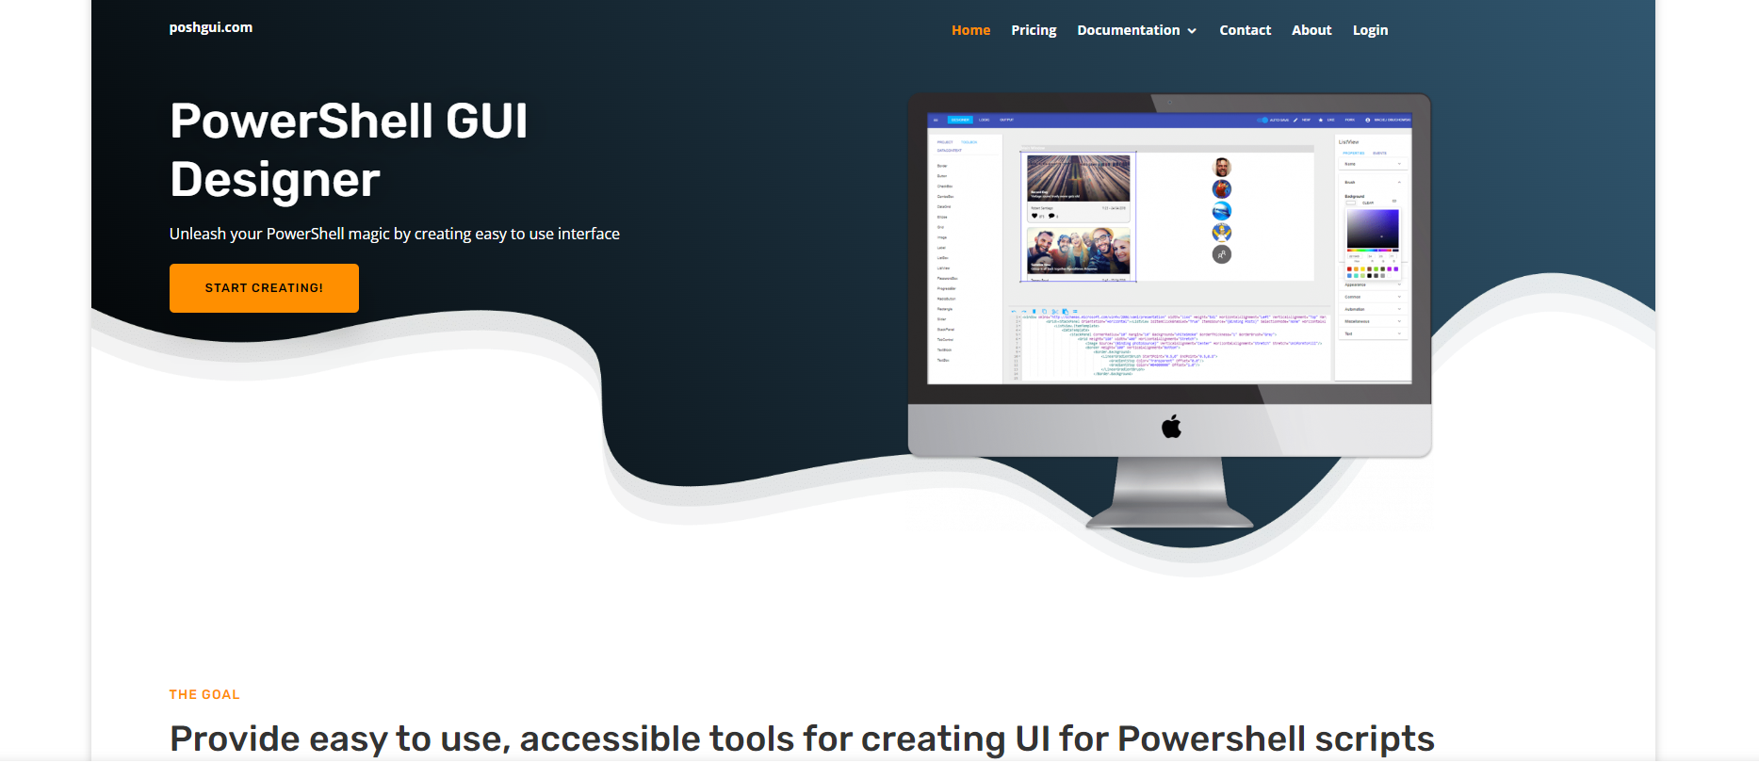
PoshGUI.com
$6.99/m
-WPF Designer
- Winforms Designer
-Cmdlet Builder
-Code Editor

Slide 12

https://github.com/jimrtyler
Code Examples

Slide 13
Initializing an
Empty Form
Add-Type -AssemblyName System.Windows.Forms
[System.Windows.Forms.Application]::EnableVisualStyles()
$Form = New-Object system.Windows.Forms.Form $Form.ClientSize = New-Object System.Drawing.Point(600,600) $Form.text = "Form" $Form.TopMost = $false
[void]$Form.ShowDialog()

Slide 14
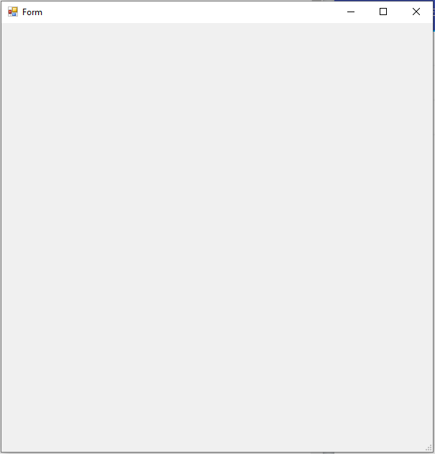
Initializing an
Empty Form

Slide 15
Label
$FirstNameLabel = New-Object system.Windows.Forms.Label $FirstNameLabel.text = "First Name:" $FirstNameLabel.AutoSize = $true $FirstNameLabel.width = 25 $FirstNameLabel.height = 10 $FirstNameLabel.location = New-Object System.Drawing.Point(13,14) $FirstNameLabel.Font = New-Object System.Drawing.Font('Microsoft Sans Serif',10)
$Form.controls.AddRange(@($FirstNameLabel))
[void]$Form.ShowDialog()

Slide 16
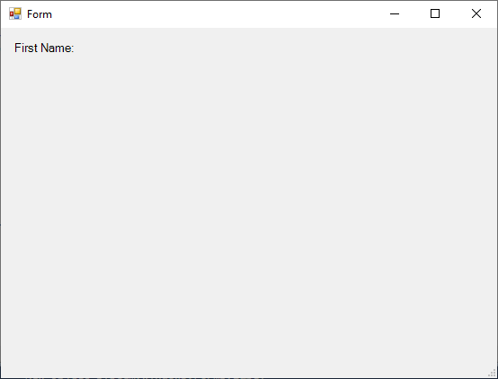
Label

Slide 17
Text Box
$FirstNameTextBox = New-Object system.Windows.Forms.TextBox $FirstNameTextBox.multiline = $false $FirstNameTextBox.width = 100 $FirstNameTextBox.height = 20 $FirstNameTextBox.location = New-Object System.Drawing.Point(93,10) $FirstNameTextBox.Font = New-Object System.Drawing.Font('Microsoft Sans Serif',10)
$Form.controls.AddRange(@($FirstNameLabel,$FirstNameTextBox))
[void]$Form.ShowDialog()

Slide 18
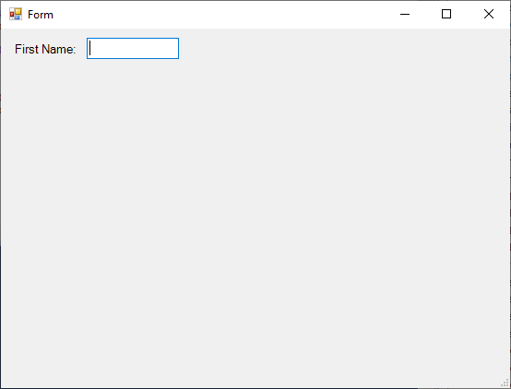
Text Box

Slide 19
Button
$SubmitBtn = New-Object system.Windows.Forms.Button $SubmitBtn.text = "Submit" $SubmitBtn.width = 60 $SubmitBtn.height = 30 $SubmitBtn.location = New-Object System.Drawing.Point(203,8) $SubmitBtn.Font = New-Object System.Drawing.Font('Microsoft Sans Serif',10)

Slide 20
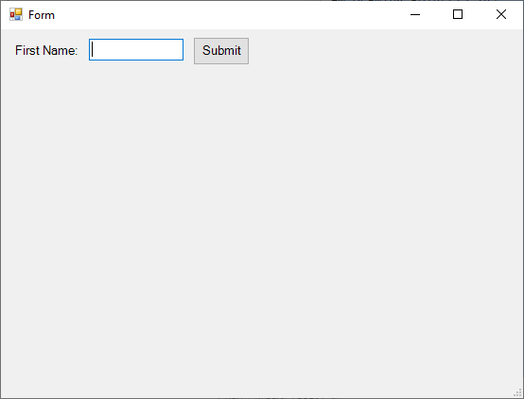
Button

Slide 21
Checkbox
$AddPrinterCheckBox = New-Object system.Windows.Forms.CheckBox $AddPrinterCheckBox.text = "Add Printer" $AddPrinterCheckBox.AutoSize = $false $AddPrinterCheckBox.width = 95 $AddPrinterCheckBox.height = 20 $AddPrinterCheckBox.location = New-Object System.Drawing.Point(47,49) $AddPrinterCheckBox.Font = New-Object System.Drawing.Font('Microsoft Sans Serif',10)

Slide 22
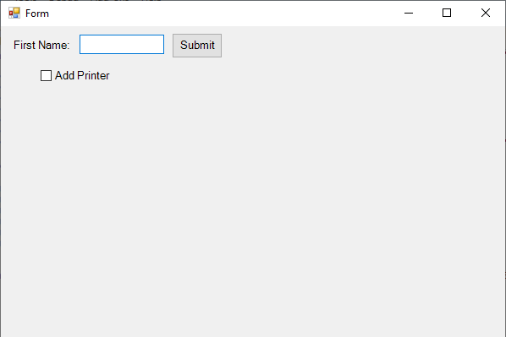
Checkbox

Slide 23
Combo Box
$ChooseBuildingComboBox = New-Object system.Windows.Forms.ComboBox $ChooseBuildingComboBox.text = "Choose Building" $ChooseBuildingComboBox.width = 186 $ChooseBuildingComboBox.height = 20 $ChooseBuildingComboBox.location = New-Object System.Drawing.Point(54,92) $ChooseBuildingComboBox.Font = New-Object System.Drawing.Font('Microsoft Sans Serif',10)

Slide 24
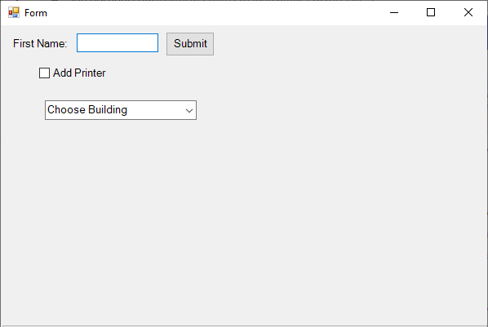
Combo Box

Slide 25
Picture Box
$PictureBox1 = New-Object system.Windows.Forms.PictureBox $PictureBox1.width = 192 $PictureBox1.height = 167 $PictureBox1.location = New-Object System.Drawing.Point(340,28) $PictureBox1.imageLocation = "https://upload.wikimedia.org/wikipedia/commons/a/af/PowerShell_Core_6.0_icon.png" $PictureBox1.SizeMode = [System.Windows.Forms.PictureBoxSizeMode]::zoom

Slide 26
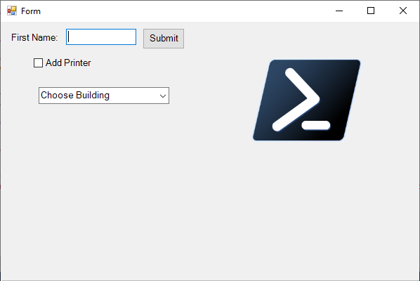
Picture Box

Slide 27
Show/Hide
Console
# .Net methods for hiding/showing the console in the background Add-Type -Name Window -Namespace Console -MemberDefinition ' [DllImport("Kernel32.dll")] public static extern IntPtr GetConsoleWindow(); [DllImport("user32.dll")] public static extern bool ShowWindow(IntPtr hWnd, Int32 nCmdShow); '

Slide 28
Active Directory
User Add Form

Slide 29

Making Windows Forms
Applications
with ChatGPT

Slide 30
Show/Hide
Console
function Show-Console {
$consolePtr = [Console.Window]::GetConsoleWindow()
# Hide = 0, # ShowNormal = 1, # ShowMinimized = 2, # ShowMaximized = 3, # Maximize = 3, # ShowNormalNoActivate = 4, # Show = 5, # Minimize = 6, # ShowMinNoActivate = 7, # ShowNoActivate = 8, # Restore = 9, # ShowDefault = 10, # ForceMinimized = 11 [Console.Window]::ShowWindow($consolePtr, 4)
}

Slide 31
Show/Hide
Console
function Hide-Console { $consolePtr = [Console.Window]::GetConsoleWindow() #0 hide [Console.Window]::ShowWindow($consolePtr, 0)
} Hide-Console

Slide 32
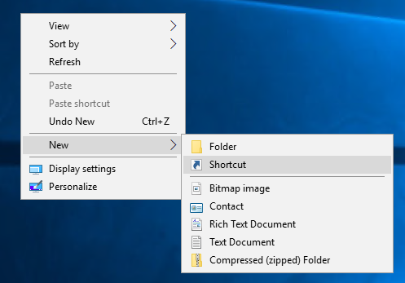
One-Click
Run Script

Slide 33
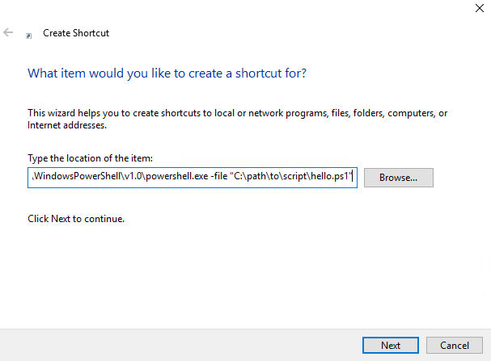
One-Click
Run Script
C:\Windows\System32\WindowsPowerShell\v1.0\powershell.exe -file "C:\path\to\script\hello.ps1"

Slide 34
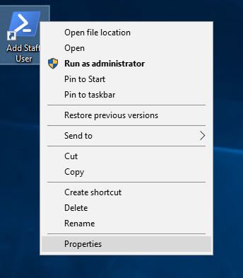
Run As
Administrator

Slide 35
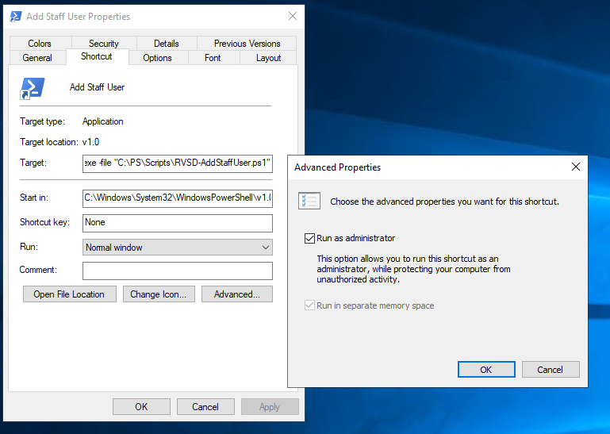
Run As
Administrator

Slide 36
Questions?

Slide 37

Install-Module ps2exe

Slide 38
Auf Wiedersehen
YouTube
https://youtube.com/@PowerShellEngineer
LinkedIn: https://linkedin.com/in/jamestyler

